Slide 1

Pattern-independent
Demosaicing;
Presented by Daniel Khashabi
Joint work with Sebastian Nowozin, Jeremy Jancsary, Andrew W. Fitzgibbon and Bruce Lindbloom

Slide 2
Outline
Demosaicing problem
Creating input-output pairs
Our demosaicing model
Experiments

Slide 3
A simple camera pipeline
Scene
Optical operations
Color Filter Array (CFA)
Analog/Digital Conversion
Linear Transformations: black-level adjustment and color scaling
Camera output (sRGB)
Image correction: 3x3 color transform and Gamma correction (nonlinear)
Demosaicing

Slide 4
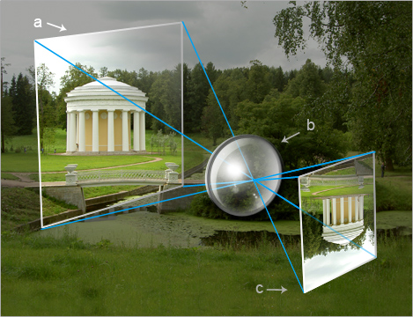
A simple camera pipeline
Scene
Optical operations
Color Filter Array (CFA)
Analog/Digital Conversion
Linear Transformations: black-level adjustment and color scaling
Camera output (sRGB)
Image correction: 3x3 color transform and Gamma correction (nonlinear)
Demosaicing

Slide 5
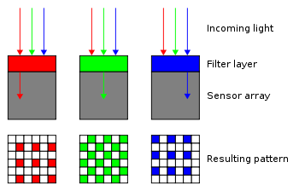
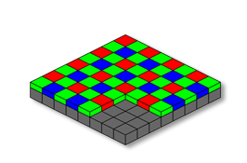
A simple camera pipeline
Scene
Optical operations
Color Filter Array (CFA)
Analog/Digital Conversion
Linear Transformations: black-level adjustment and color scaling
Camera output (sRGB)
Image correction: 3x3 color transform and Gamma correction (nonlinear)
Demosaicing

Slide 6
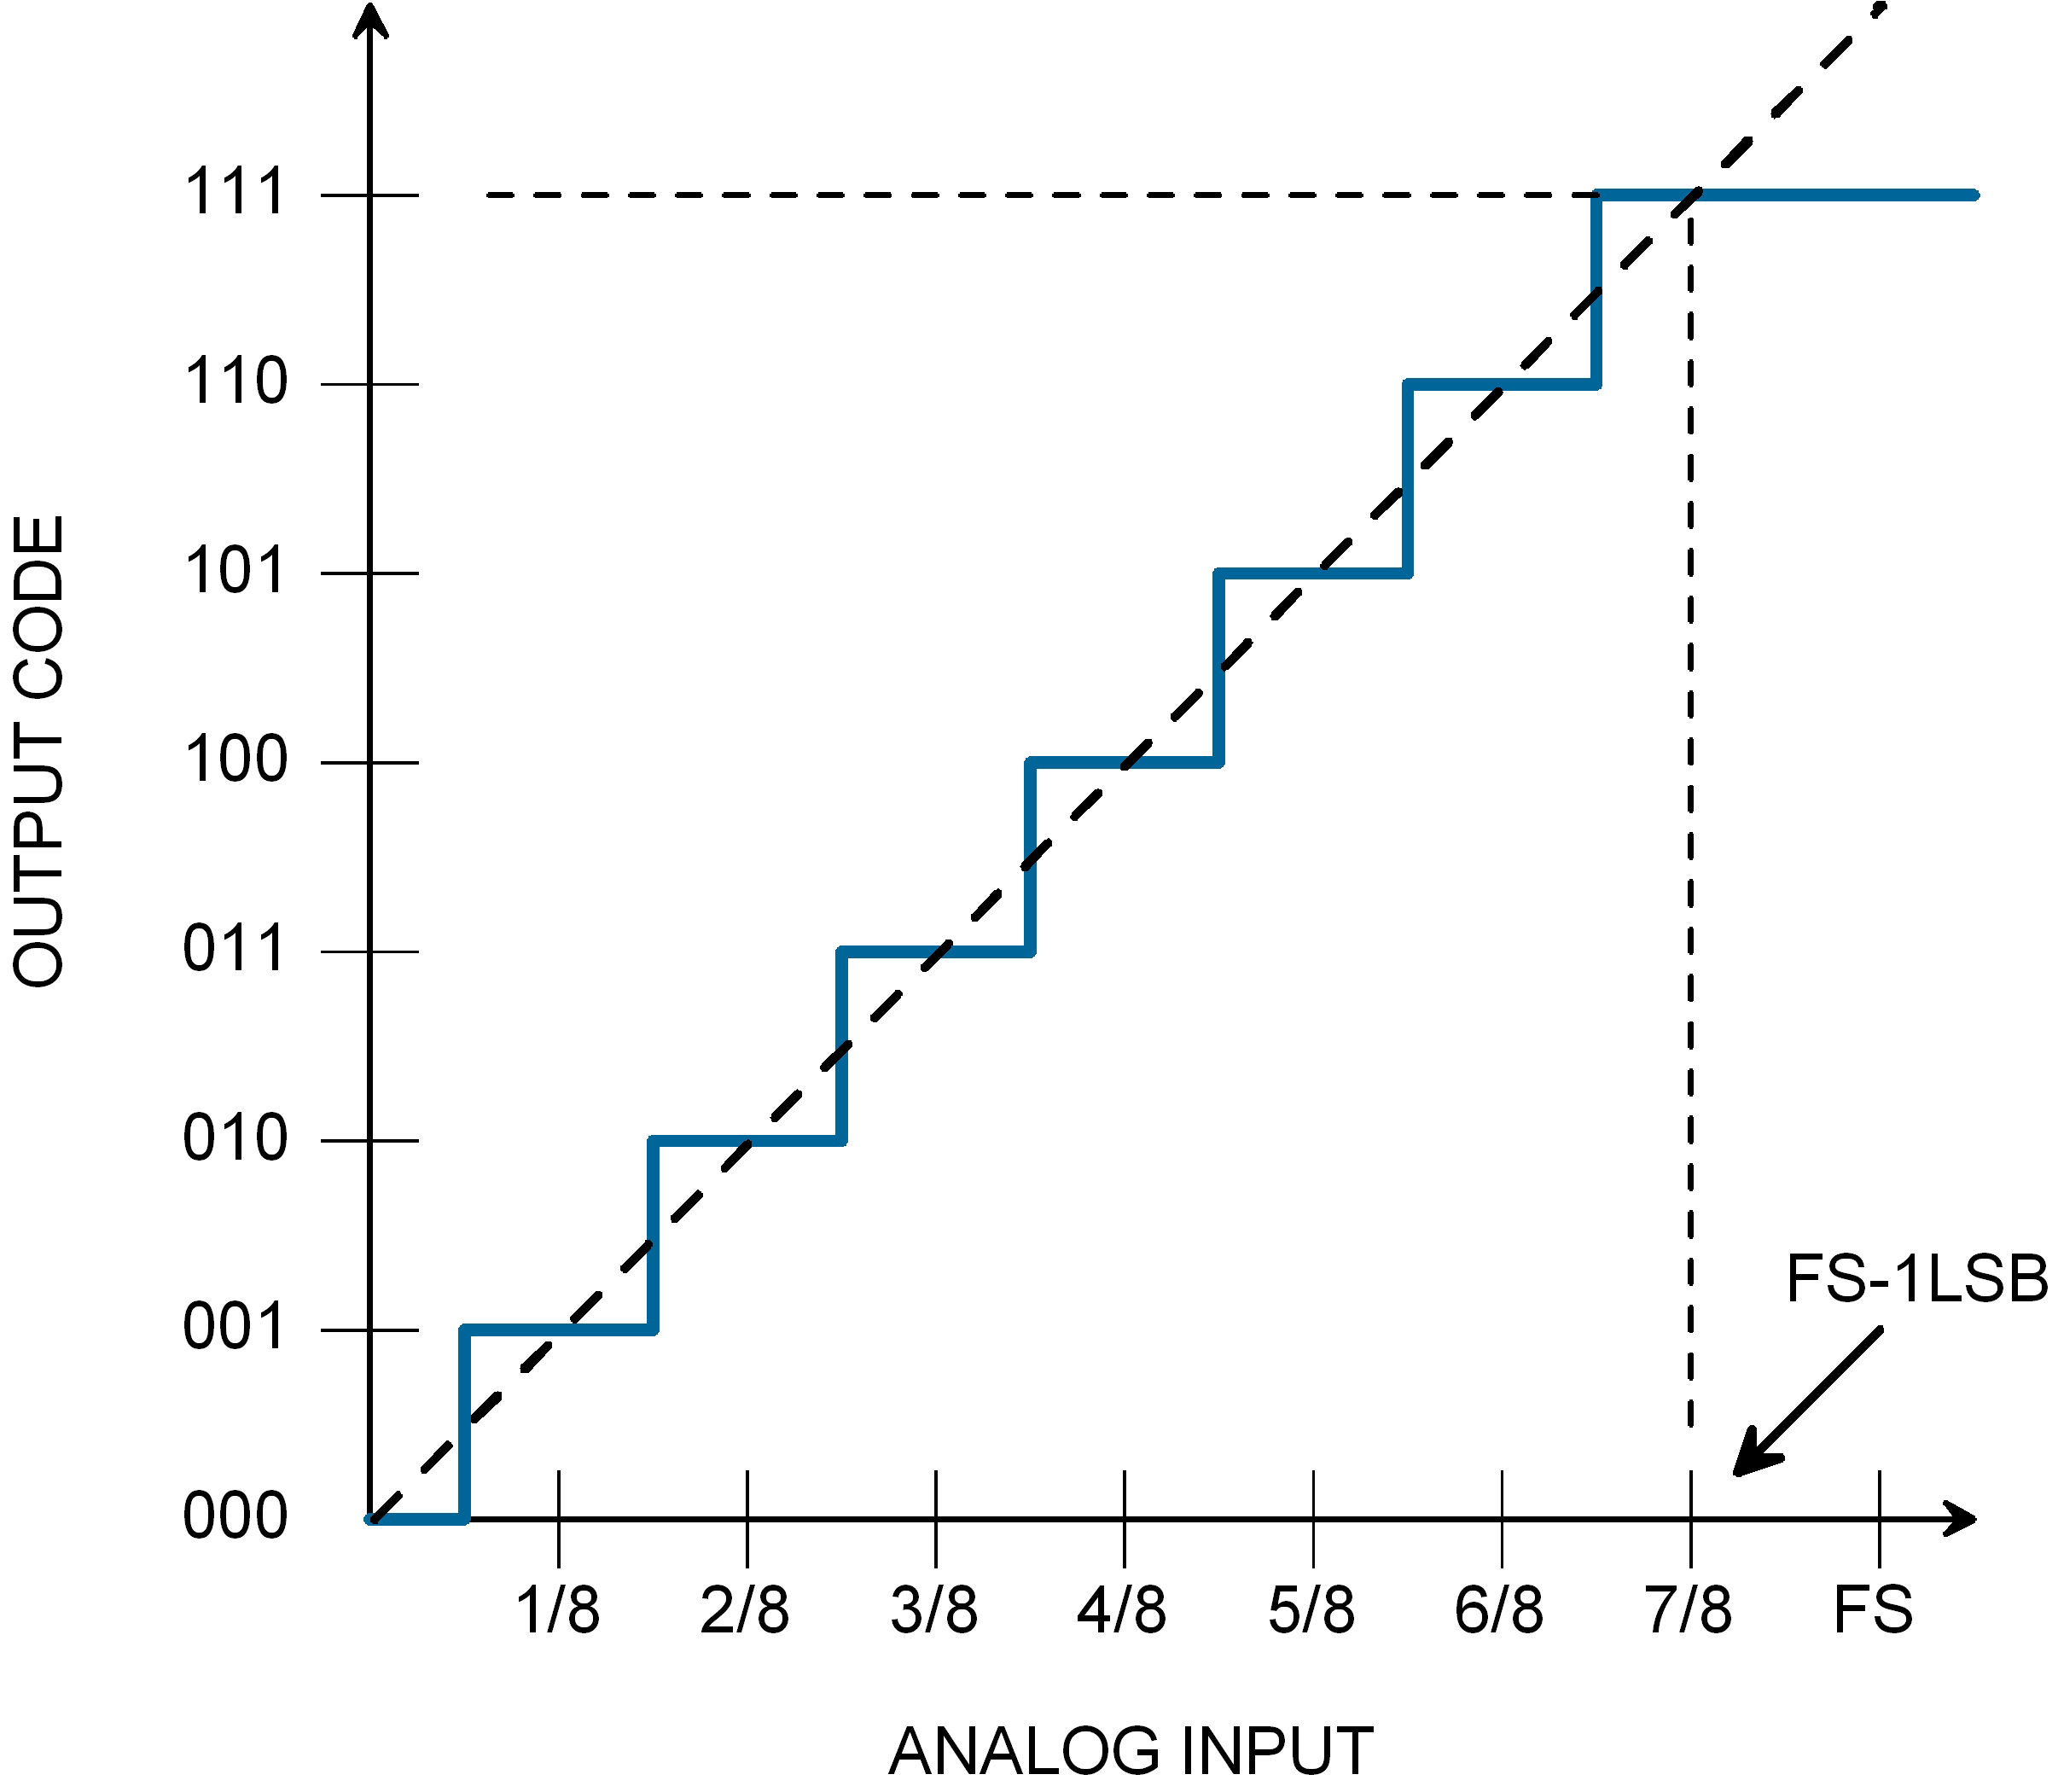
A simple camera pipeline
Scene
Optical operations
Color Filter Array (CFA)
Analog/Digital Conversion
Linear Transformations: black-level adjustment and color scaling
Camera output (sRGB)
Image correction: 3x3 color transform and Gamma correction (nonlinear)
Demosaicing

Slide 7
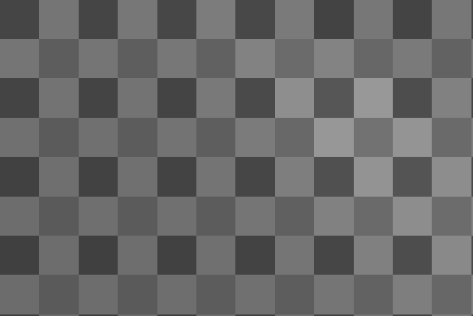
Raw Spcae
A simple camera pipeline
Scene
Optical operations
Color Filter Array (CFA)
Analog/Digital Conversion
Linear Transformations: black-level adjustment and color scaling
Camera output (sRGB)
Image correction: 3x3 color transform and Gamma correction (nonlinear)
Demosaicing

Slide 8

Raw Spcae
A simple camera pipeline
Scene
Optical operations
Color Filter Array (CFA)
Analog/Digital Conversion
Linear Transformations: black-level adjustment and color scaling
Mosaiced Linear Space
Camera output (sRGB)
Image correction: 3x3 color transform and Gamma correction (nonlinear)
Demosaicing

Slide 9
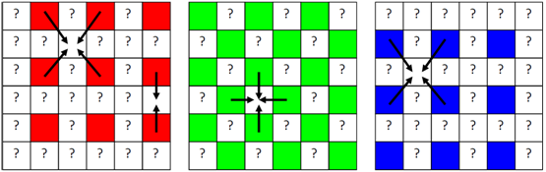
Raw Spcae
A simple camera pipeline
Scene
Optical operations
Color Filter Array (CFA)
Analog/Digital Conversion
Linear Transformations: black-level adjustment and color scaling
Mosaiced Linear Space
Camera output (sRGB)
Image correction: 3x3 color transform and Gamma correction (nonlinear)
Demosaicing
Demosaiced Linear Space

Slide 10
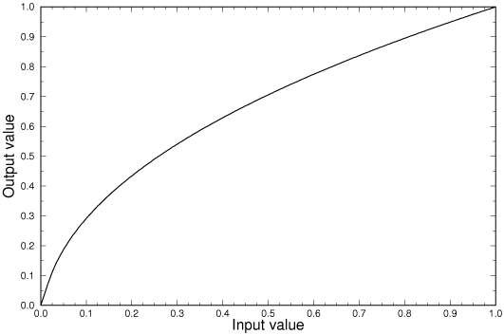
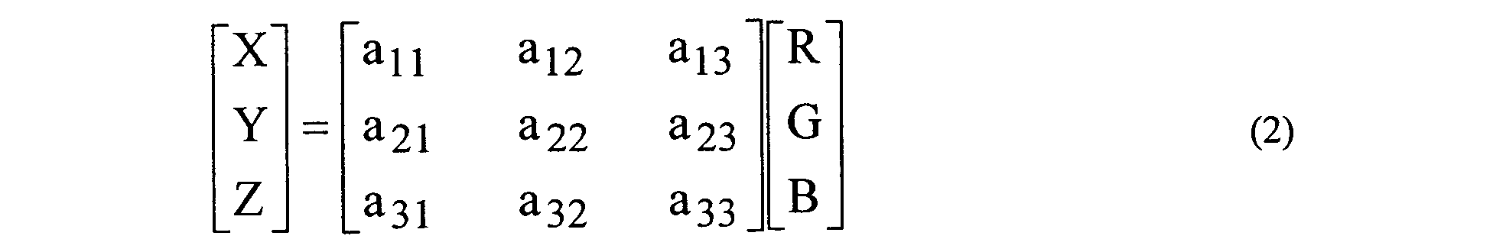
Raw Spcae
A simple camera pipeline
Scene
Optical operations
Color Filter Array (CFA)
Analog/Digital Conversion
Linear Transformations: black-level adjustment and color scaling
Mosaiced Linear Space
Camera output (sRGB)
Image correction: 3x3 color transform and Gamma correction (nonlinear)
Demosaicing
Demosaiced Linear Space
sRGB Space

Slide 11
Raw Spcae
A simple camera pipeline
Scene
Optical operations
Color Filter Array (CFA)
Analog/Digital Conversion
Linear Transformations: black-level adjustment and color scaling
Mosaiced Linear Space
Camera output (sRGB)
Image correction: 3x3 color transform and Gamma correction (nonlinear)
Demosaicing
Demosaiced Linear Space
sRGB Space

Slide 12
Raw Spcae
A simple camera pipeline
Scene
Optical operations
Color Filter Array (CFA)
Analog/Digital Conversion
Linear Transformations: black-level adjustment and color scaling
Mosaiced Linear Space
Camera output (sRGB)
Image correction: 3x3 color transform and Gamma correction (nonlinear)
Demosaicing
Demosaiced Linear Space
sRGB Space
Images from: http://pho.to/media/images/digital/digital-techlology.jpg

Slide 13
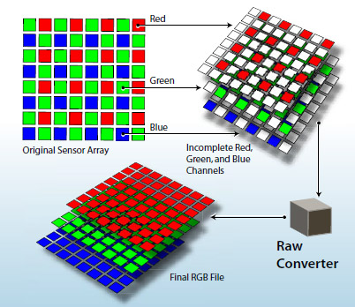
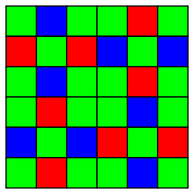
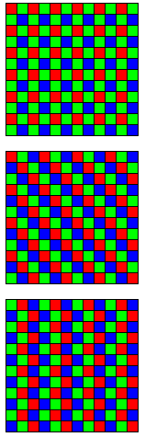
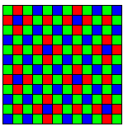
Raw Spcae
Demosaicing
Interpolating color-filter-array (CFA) samples to create full-resolution color images
Mosaiced Linear Space
Fuji X-trans
Demosaiced Linear Space
sRGB Space
Image from: http://i.i.cbsi.com/cnwk.1d/i/tim/2012/02/06/Adobe-raw-demosaic-diagram.jpg

Slide 14
Raw Spcae
Demosaicing
Interpolating color-filter-array (CFA) samples to create full-resolution color images
Isn’t a solved problem?! NO!
Mosaiced Linear Space
Fuji X-trans
Demosaiced Linear Space
sRGB Space
Image from: http://i.i.cbsi.com/cnwk.1d/i/tim/2012/02/06/Adobe-raw-demosaic-diagram.jpg

Slide 15
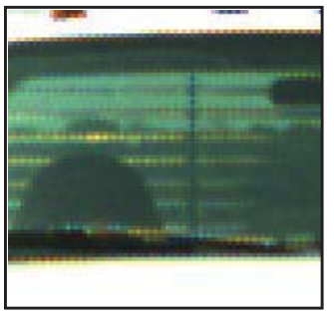
Raw Spcae
Demosaicing
Interpolating color-filter-array (CFA) samples to create full-resolution color images
Isn’t a solved problem?! NO!
The current methods are can be improved in terms of performance
Zippering effect still present in the output of many current method
Mosaiced Linear Space
Fuji X-trans
Demosaiced Linear Space
sRGB Space
Image from: http://i.i.cbsi.com/cnwk.1d/i/tim/2012/02/06/Adobe-raw-demosaic-diagram.jpg

Slide 16
Raw Spcae
Demosaicing
Interpolating color-filter-array (CFA) samples to create full-resolution color images
Isn’t a solved problem?! NO!
The current methods are can be improved in terms of performance
Zippering effect still present in the output of many current method
Mosaiced Linear Space
Fuji X-trans
Demosaiced Linear Space
sRGB Space
Image from: http://i.i.cbsi.com/cnwk.1d/i/tim/2012/02/06/Adobe-raw-demosaic-diagram.jpg

Slide 17
Raw Spcae
Demosaicing
Interpolating color-filter-array (CFA) samples to create full-resolution color images
Isn’t a solved problem?! NO!
The current methods are can be improved in terms of performance
Zippering effect still present in the output of many current method
The current methods are CFA-specific (mostly Bayer pattern) And not easily generalizable to new CFAs
Mosaiced Linear Space
Fuji X-trans
Demosaiced Linear Space
Bayer Pattern
sRGB Space
Image from: http://i.i.cbsi.com/cnwk.1d/i/tim/2012/02/06/Adobe-raw-demosaic-diagram.jpg

Slide 18
Raw Spcae
Demosaicing
Interpolating color-filter-array (CFA) samples to create full-resolution color images
Isn’t a solved problem?! NO!
The current methods are can be improved in terms of performance
Zippering effect still present in the output of many current method
The current methods are CFA-specific (mostly Bayer pattern) And not easily generalizable to new CFAs
Mosaiced Linear Space
Fuji X-trans
Demosaiced Linear Space
Bayer Pattern
sRGB Space
Image from: http://i.i.cbsi.com/cnwk.1d/i/tim/2012/02/06/Adobe-raw-demosaic-diagram.jpg

Slide 19
Raw Spcae
Demosaicing
Interpolating color-filter-array (CFA) samples to create full-resolution color images
Isn’t a solved problem?! NO!
The current methods are can be improved in terms of performance
Zippering effect still present in the output of many current method
The current methods are CFA-specific (mostly Bayer pattern) And not easily generalizable to new CFAs
Mosaiced Linear Space
Demosaiced Linear Space
sRGB Space
Image from: http://i.i.cbsi.com/cnwk.1d/i/tim/2012/02/06/Adobe-raw-demosaic-diagram.jpg

Slide 20
Raw Spcae
Demosaicing
Interpolating color-filter-array (CFA) samples to create full-resolution color images
Isn’t a solved problem?! NO!
The current methods are can be improved in terms of performance
Zippering effect still present in the output of many current method
The current methods are CFA-specific (mostly Bayer pattern) And not easily generalizable to new CFAs
All method are engineered for sRGB images
Demosaicing is lacking a good dataset
Mosaiced Linear Space
Demosaiced Linear Space
sRGB Space
Image from: http://i.i.cbsi.com/cnwk.1d/i/tim/2012/02/06/Adobe-raw-demosaic-diagram.jpg

Slide 21
Raw Spcae
Demosaicing
Interpolating color-filter-array (CFA) samples to create full-resolution color images
Isn’t a solved problem?! NO!
The current methods are can be improved in terms of performance
Zippering effect still present in the output of many current method
The current methods are CFA-specific (mostly Bayer pattern) And not easily generalizable to new CFAs
All method are engineered for sRGB images
Demosaicing is lacking a good dataset
Mosaiced Linear Space
Demosaiced Linear Space
sRGB Space
Image from: http://i.i.cbsi.com/cnwk.1d/i/tim/2012/02/06/Adobe-raw-demosaic-diagram.jpg

Slide 22
Demosaicing
Interpolating color-filter-array (CFA) samples to create full-resolution color images
Isn’t a solved problem?! NO!
The current methods are can be improved in terms of performance
Zippering effect still present in the output of many current method
The current methods are CFA-specific (mostly Bayer pattern) And not easily generalizable to new CFAs
All method are engineered for sRGB images
Demosaicing is lacking a good dataset
Many of low-level task could be done before/joint with demosaicing
Noise behaviour changes after demosaicing
Image from: http://i.i.cbsi.com/cnwk.1d/i/tim/2012/02/06/Adobe-raw-demosaic-diagram.jpg

Slide 23
Raw Spcae
Overview of our approach
Mosaiced Linear Space
Demosaiced Linear Space
sRGB Space

Slide 24
Raw Spcae
Overview of our approach
We design a supervised model.
Mosaiced Linear Space
Demosaiced Linear Space
sRGB Space

Slide 25
Raw Spcae
Overview of our approach
We design a supervised model.
For training the model we propose a procedure to create the ground truth dataset from light-space images
Mosaiced Linear Space
Demosaiced Linear Space
sRGB Space

Slide 26
Raw Spcae
Overview of our approach
We design a supervised model.
For training the model we propose a procedure to create the ground truth dataset from light-space images
Mosaiced Linear Space
Demosaiced Linear Space
sRGB Space

Slide 27
Raw Spcae
Overview of our approach
We design a supervised model.
For training the model we propose a procedure to create the ground truth dataset from light-space images
Our dataset is will be published with our work.
Mosaiced Linear Space
Demosaiced Linear Space
sRGB Space

Slide 28
Raw Spcae
Overview of our approach
We design a supervised model.
For training the model we propose a procedure to create the ground truth dataset from light-space images
Our dataset is will be published with our work.
Our model is easily generalizable to different CFA patterns.
Mosaiced Linear Space
Demosaiced Linear Space
sRGB Space

Slide 29
Raw Spcae
Overview of our approach
We design a supervised model.
For training the model we propose a procedure to create the ground truth dataset from light-space images
Our dataset is will be published with our work.
Our model is easily generalizable to different CFA patterns.
Our model can perform denoising jointly with demosaicing.
Mosaiced Linear Space
Demosaiced Linear Space
sRGB Space

Slide 30
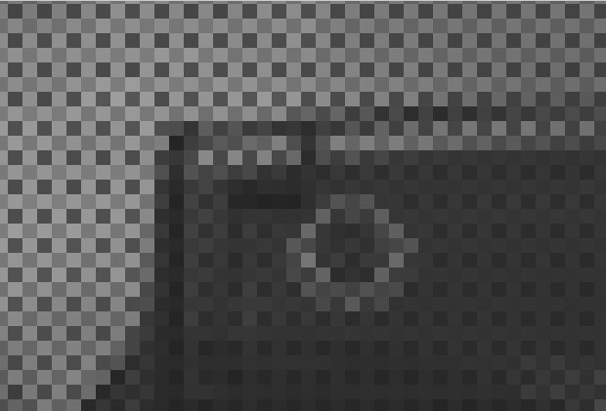
Raw Spcae
Creating ground-truth images
Mosaiced Linear Space
Demosaiced Linear Space
sRGB Space

Slide 31
Raw Spcae
Creating ground-truth images
We want to design set of input-output pairs in linear light-space
Mosaiced Linear Space
Demosaiced Linear Space
sRGB Space

Slide 32
Raw Spcae
Creating ground-truth images
We want to design set of input-output pairs in linear light-space
We use the fact that images are scale-invariant
regardless of some properties like noise distribution
Mosaiced Linear Space
Demosaiced Linear Space
sRGB Space

Slide 33
Raw Spcae
Creating ground-truth images
We want to design set of input-output pairs in linear light-space
We use the fact that images are scale-invariant
regardless of some properties like noise distribution
Mosaiced Linear Space
Demosaiced Linear Space
sRGB Space

Slide 34
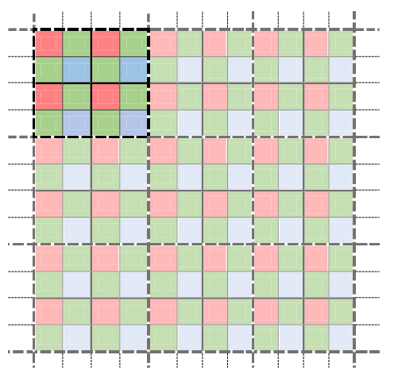
Raw Spcae
Creating ground-truth images
We want to design set of input-output pairs in linear light-space
We use the fact that images are scale-invariant
regardless of some properties like noise distribution
Mosaiced Linear Space
Demosaiced Linear Space
sRGB Space

Slide 35
Raw Spcae
Creating ground-truth images
We want to design set of input-output pairs in linear light-space
We use the fact that images are scale-invariant
regardless of some properties like noise distribution
Mosaiced Linear Space
Virtual sensor
Demosaiced Linear Space
sRGB Space

Slide 36
Raw Spcae
Creating ground-truth images
We want to design set of input-output pairs in linear light-space
We use the fact that images are scale-invariant
regardless of some properties like noise distribution
Mosaiced Linear Space
Virtual sensor
Demosaiced Linear Space
sRGB Space

Slide 37
Raw Spcae
Creating ground-truth images
We want to design set of input-output pairs in linear light-space
We use the fact that images are scale-invariant
regardless of some properties like noise distribution
Mosaiced Linear Space
Virtual sensor
Demosaiced Linear Space
sRGB Space

Slide 38
Raw Spcae
Creating ground-truth images
We want to design set of input-output pairs in linear light-space
We use the fact that images are scale-invariant
regardless of some properties like noise distribution
Mosaiced Linear Space
Virtual sensor
Demosaiced Linear Space
Ground truth output image
sRGB Space

Slide 39
Raw Spcae
Creating ground-truth images
We want to design set of input-output pairs in linear light-space
We use the fact that images are scale-invariant
regardless of some properties like noise distribution
Mosaiced Linear Space
Virtual sensor
Demosaiced Linear Space
Ground truth output image
sRGB Space

Slide 40
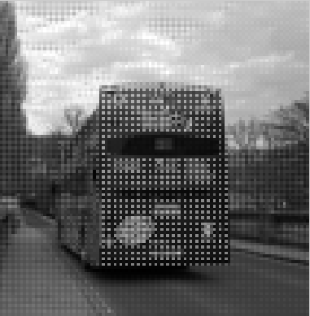
Raw Spcae
Creating ground-truth images
We want to design set of input-output pairs in linear light-space
We use the fact that images are scale-invariant
regardless of some properties like noise distribution
Mosaiced Linear Space
Ground truth input image
Virtual sensor
Demosaiced Linear Space
Ground truth output image
sRGB Space

Slide 41
down-scaling strategies
There is a systematic bias between red and blue, when the size of the square is even

Slide 42

down-scaling strategies
There is a systematic bias between red and blue, when the size of the square is even

Slide 43

down-scaling strategies
There is a systematic bias between red and blue, when the size of the square is even

Slide 44
down-scaling strategies
There is a systematic bias between red and blue, when the size of the square is even
When the size of the block is odd, this systematic bias vanishes, but the ratio of color sensors are different
This ratio goes to one, when the size of the block increases

Slide 45
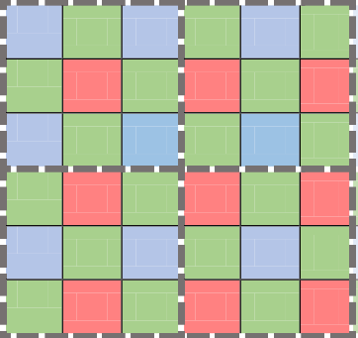
down-scaling strategies
There is a systematic bias between red and blue, when the size of the square is even
When the size of the block is odd, this systematic bias vanishes, but the ratio of color sensors are different
This ratio goes to one, when the size of the block increases

Slide 46

down-scaling strategies
There is a systematic bias between red and blue, when the size of the square is even
When the size of the block is odd, this systematic bias vanishes, but the ratio of color sensors are different
This ratio goes to one, when the size of the block increases

Slide 47
down-scaling strategies
There is a systematic bias between red and blue, when the size of the square is even
When the size of the block is odd, this systematic bias vanishes, but the ratio of color sensors are different
This ratio goes to one, when the size of the block increases
We devised a strategy to compensate for the systematic bias when the size of the window is even

Slide 48
Max-Ent down-scaling
Goal:
Want to bring the center of the mass, for each color, to the center of each block

Slide 49
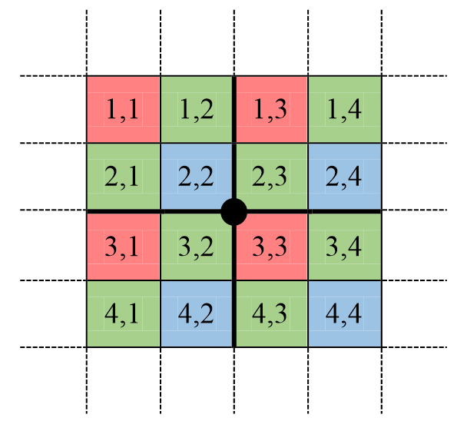
Max-Ent down-scaling
Goal:
Want to bring the center of the mass, for each color, to the center of each block

Slide 50
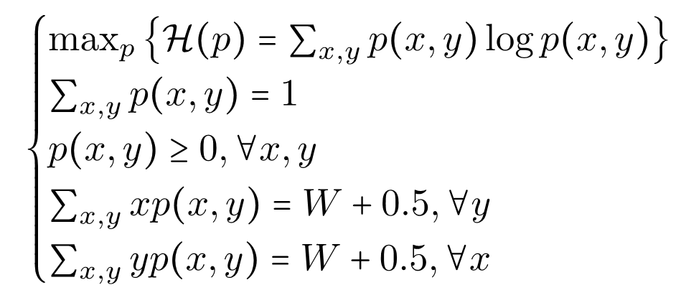
Max-Ent down-scaling
Goal:
Want to bring the center of the mass, for each color, to the center of each block

Slide 51
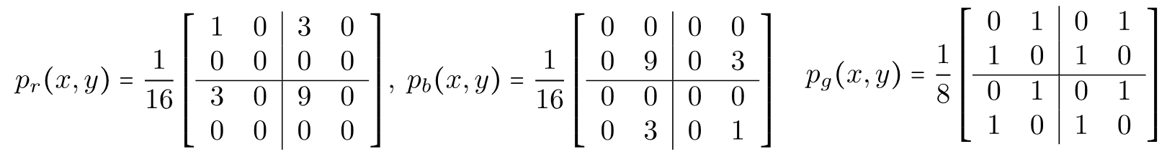
Max-Ent down-scaling
Goal:
Want to bring the center of the mass, for each color, to the center of each block

Slide 52

Max-Ent down-scaling
Goal:
Want to bring the center of the mass, for each color, to the center of each block
Uniform
MaxEnt

Slide 53
Down-scaling, a real example

Slide 54
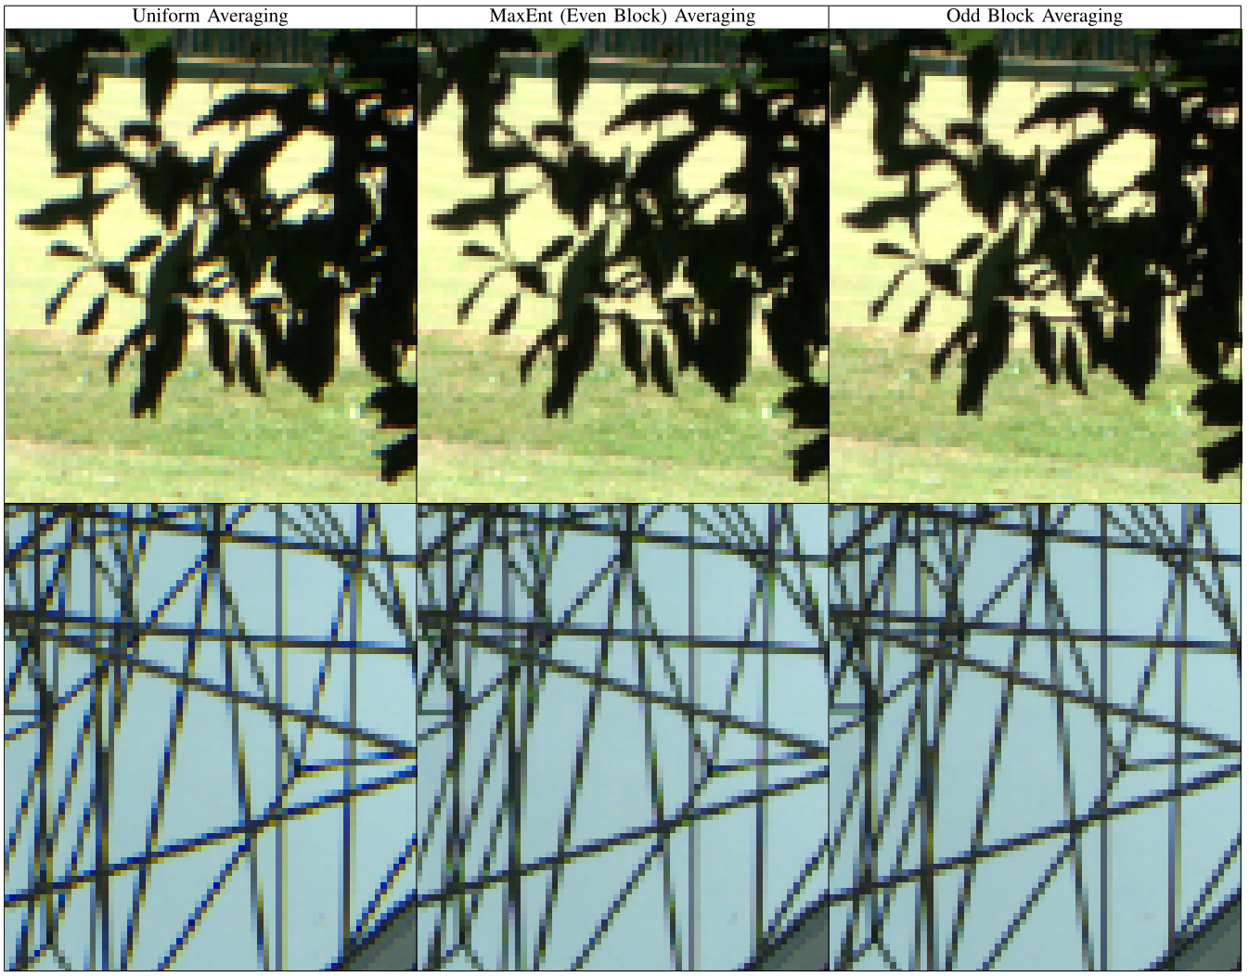
Down-scaling, a real example

Slide 55
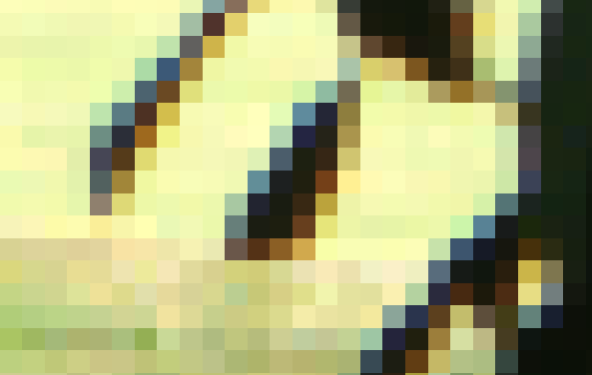
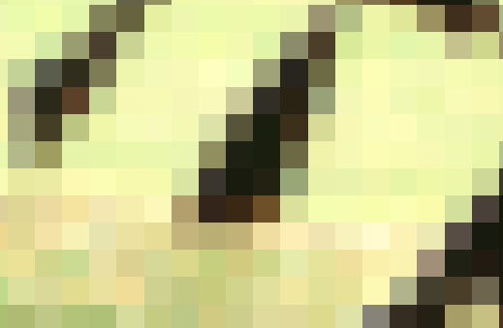
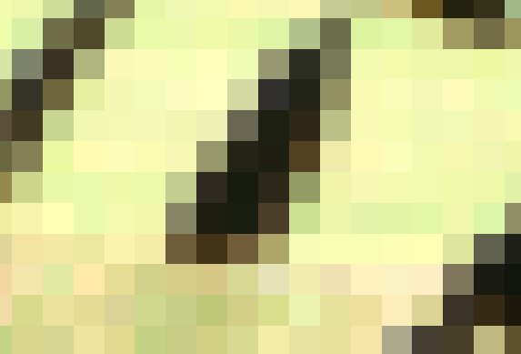
Down-scaling, a real example

Slide 56
Down-scaling, a real example

Slide 57
Down-scaling, a real example

Slide 58
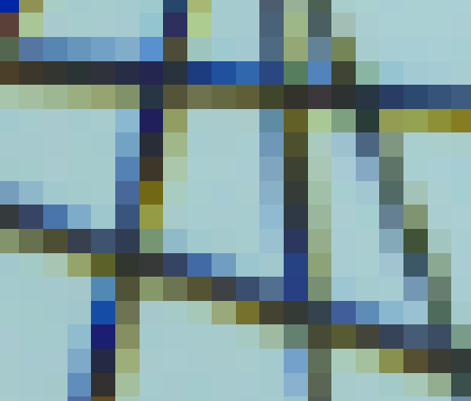
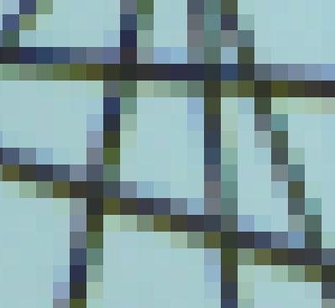
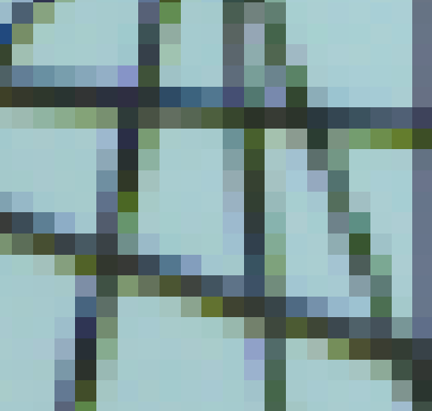
Down-scaling, a real example

Slide 59
Creating ground-truth images

Slide 60
Creating ground-truth images
Collected 500 raw images captured by Panasonic-Lumix LX-3
We need to be able to go along a good camera pipeline

Slide 61
Creating ground-truth images
Collected 500 raw images captured by Panasonic-Lumix LX-3
We need to be able to go along a good camera pipeline
We use dcraw to transfer images to different stages in camera pipeline
Raw images
Linear Transformations: black-level adjustment and color scaling
Demosaicing
Image correction: 3x3 color transform and Gamma correction (nonlinear)
Camera output (sRGB)

Slide 62
Creating ground-truth images
Collected 500 raw images captured by Panasonic-Lumix LX-3
We need to be able to go along a good camera pipeline
We use dcraw to transfer images to different stages in camera pipeline
We write out the specifications of each step, for each image
Raw images
Linear Transformations: black-level adjustment and color scaling
Demosaicing
Image correction: 3x3 color transform and Gamma correction (nonlinear)
Camera output (sRGB)

Slide 63
Creating ground-truth images
Collected 500 raw images captured by Panasonic-Lumix LX-3
We need to be able to go along a good camera pipeline
We use dcraw to transfer images to different stages in camera pipeline
We write out the specifications of each step, for each image
Raw images
Linear Transformations: black-level adjustment and color scaling
Demosaicing
Image correction: 3x3 color transform and Gamma correction (nonlinear)
Camera output (sRGB)

Slide 64
Creating ground-truth images
Collected 500 raw images captured by Panasonic-Lumix LX-3
We need to be able to go along a good camera pipeline
We use dcraw to transfer images to different stages in camera pipeline
We write out the specifications of each step, for each image
Then simulate our own pipeline in MATLAB, with demosaicing replaced with our own down-scaling
Raw images
Linear Transformations: black-level adjustment and color scaling
Demosaicing
Image correction: 3x3 color transform and Gamma correction (nonlinear)
Camera output (sRGB)
Raw images
Linear Transformations: black-level adjustment and color scaling
Down-scaling
Image correction: 3x3 color transform and Gamma correction (nonlinear)
Camera output (sRGB)

Slide 65
Creating ground-truth images
Collected 500 raw images captured by Panasonic-Lumix LX-3
We need to be able to go along a good camera pipeline
We use dcraw to transfer images to different stages in camera pipeline
We write out the specifications of each step, for each image
Then simulate our own pipeline in MATLAB, with demosaicing replaced with our own down-scaling
Raw images
Linear Transformations: black-level adjustment and color scaling
Demosaicing
Image correction: 3x3 color transform and Gamma correction (nonlinear)
Camera output (sRGB)
Raw images
Linear Transformations: black-level adjustment and color scaling
Down-scaling
Image correction: 3x3 color transform and Gamma correction (nonlinear)
Camera output (sRGB)

Slide 66
Creating ground-truth images
Collected 500 raw images captured by Panasonic-Lumix LX-3
We need to be able to go along a good camera pipeline
We use dcraw to transfer images to different stages in camera pipeline
We write out the specifications of each step, for each image
Then simulate our own pipeline in MATLAB, with demosaicing replaced with our own down-scaling
Raw images
Linear Transformations: black-level adjustment and color scaling
Demosaicing
Image correction: 3x3 color transform and Gamma correction (nonlinear)
Camera output (sRGB)
Ground truth output image
Raw images
Linear Transformations: black-level adjustment and color scaling
Down-scaling
Image correction: 3x3 color transform and Gamma correction (nonlinear)
Camera output (sRGB)

Slide 67
Creating ground-truth images
Collected 500 raw images captured by Panasonic-Lumix LX-3
We need to be able to go along a good camera pipeline
We use dcraw to transfer images to different stages in camera pipeline
We write out the specifications of each step, for each image
Then simulate our own pipeline in MATLAB, with demosaicing replaced with our own down-scaling
Raw images
Linear Transformations: black-level adjustment and color scaling
Demosaicing
Image correction: 3x3 color transform and Gamma correction (nonlinear)
Camera output (sRGB)
Ground truth output image
Raw images
Linear Transformations: black-level adjustment and color scaling
Down-scaling
Image correction: 3x3 color transform and Gamma correction (nonlinear)
Camera output (sRGB)

Slide 68
The noise behaviour in down-scaled images
Averaging decreases the noise present in images.

Slide 69
The noise behaviour in down-scaled images
Averaging decreases the noise present in images.
Need to devise a way to bring back the noise into our images
Since the goal is to perform demosaicing on the original raw images

Slide 70
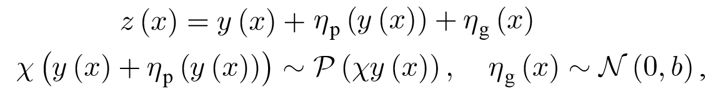
The noise behaviour in down-scaled images
Averaging decreases the noise present in images.
Need to devise a way to bring back the noise into our images
Since the goal is to perform demosaicing on the original raw images
We use a recent method of noise estimation for raw images [1]
Models as Poisson-Gaussian distribution
[1] Foi, Alessandro, et al. "Practical Poissonian-Gaussian noise modeling and fitting for single-image raw-data." Image Processing, IEEE Transactions on 17.10 (2008): 1737-1754.

Slide 71
The noise behaviour in down-scaled images
Averaging decreases the noise present in images.
Need to devise a way to bring back the noise into our images
Since the goal is to perform demosaicing on the original raw images
We use a recent method of noise estimation for raw images [1]
Models as Poisson-Gaussian distribution
We then add back the noise into images
Raw images
Linear Transformations: black-level adjustment and color scaling
Noise estimation
Down-scaling
Noise addition
Image correction: 3x3 color transform and Gamma correction (nonlinear)
Camera output (sRGB)
[1] Foi, Alessandro, et al. "Practical Poissonian-Gaussian noise modeling and fitting for single-image raw-data." Image Processing, IEEE Transactions on 17.10 (2008): 1737-1754.

Slide 72
The noise behaviour in down-scaled images
Averaging decreases the noise present in images.
Need to devise a way to bring back the noise into our images
Since the goal is to perform demosaicing on the original raw images
We use a recent method of noise estimation for raw images [1]
Models as Poisson-Gaussian distribution
We then add back the noise into images
Raw images
Linear Transformations: black-level adjustment and color scaling
Noise estimation
Down-scaling
Noise addition
Image correction: 3x3 color transform and Gamma correction (nonlinear)
Camera output (sRGB)
[1] Foi, Alessandro, et al. "Practical Poissonian-Gaussian noise modeling and fitting for single-image raw-data." Image Processing, IEEE Transactions on 17.10 (2008): 1737-1754.

Slide 73
Samples of noise-addition to image

Slide 74
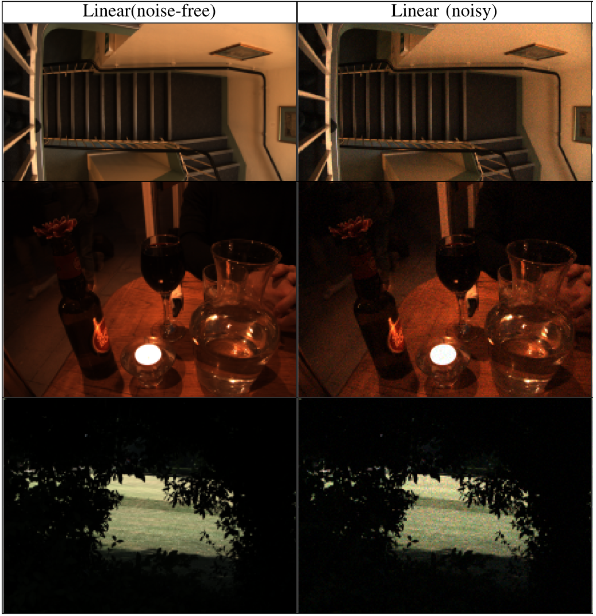
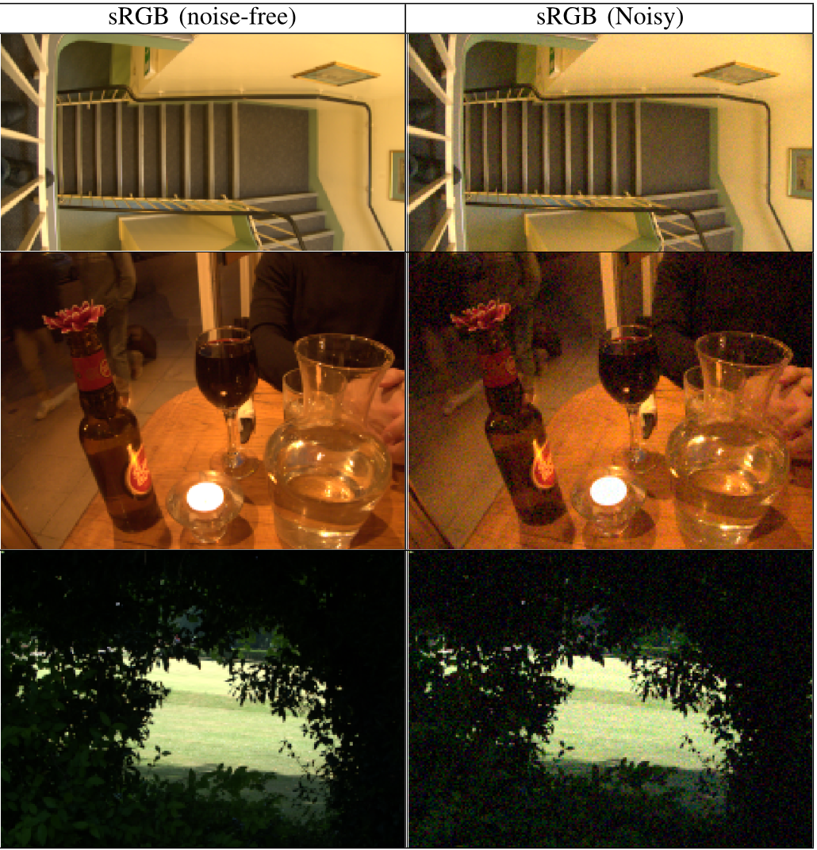
Samples of noise-addition to image

Slide 75
Samples of noise-addition to image

Slide 76
Samples of noise-addition to image

Slide 77
Raw Spcae
Possible tasks
We have developed these images
Among the above tasks we are mostly interested in doing the followings:
Demosaicing in linear light-space
Deniosing +demosaicing in linear light-spcae
Mosaiced Linear Space
Raw images
Demosaiced Linear Space
sRGB Space

Slide 78
Raw Spcae
Possible tasks
We have developed these images
Among the above tasks we are mostly interested in doing the followings:
Demosaicing in linear light-space
Deniosing +demosaicing in linear light-spcae
Noise-free-linear
Mosaiced Linear Space
Raw images
Demosaiced Linear Space
sRGB Space

Slide 79
Raw Spcae
Possible tasks
We have developed these images
Among the above tasks we are mostly interested in doing the followings:
Demosaicing in linear light-space
Deniosing +demosaicing in linear light-spcae
Noise-free-linear
Noise-free-sRGB
Mosaiced Linear Space
Raw images
Demosaiced Linear Space
sRGB Space

Slide 80
Raw Spcae
Possible tasks
We have developed these images
Among the above tasks we are mostly interested in doing the followings:
Demosaicing in linear light-space
Deniosing +demosaicing in linear light-spcae
Noise-free-linear
Noise-free-sRGB
Mosaiced Linear Space
Raw images
Noisy-linear
Demosaiced Linear Space
sRGB Space

Slide 81
Raw Spcae
Possible tasks
We have developed these images
Among the above tasks we are mostly interested in doing the followings:
Demosaicing in linear light-space
Deniosing +demosaicing in linear light-spcae
Noise-free-linear
Noise-free-sRGB
Mosaiced Linear Space
Raw images
Noisy-linear
Noisy-sRGB
Demosaiced Linear Space
sRGB Space

Slide 82
Raw Spcae
Possible tasks
We have developed these images
Among the above tasks we are mostly interested in doing the followings:
Demosaicing in linear light-space
Deniosing +demosaicing in linear light-spcae
Noise-free-linear
Noise-free-sRGB
Mosaiced Linear Space
Raw images
Noisy-linear
Noisy-sRGB
Demosaiced Linear Space
sRGB Space

Slide 83
Raw Spcae
Possible tasks
We have developed these images
Among the above tasks we are mostly interested in doing the followings:
Demosaicing in linear light-space
Deniosing +demosaicing in linear light-spcae
Noise-free-linear
Noise-free-sRGB
Mosaiced Linear Space
Raw images
Noisy-linear
Noisy-sRGB
Demosaiced Linear Space
sRGB Space

Slide 84
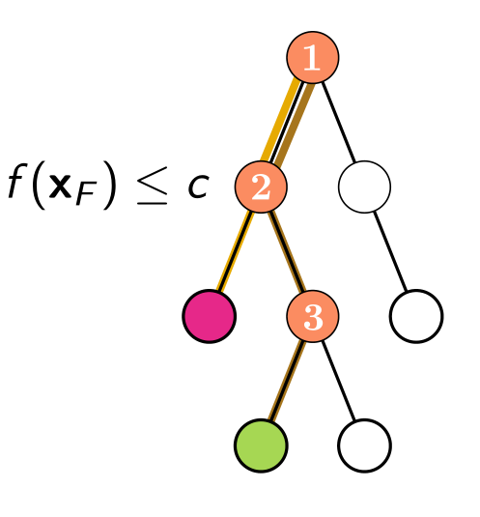
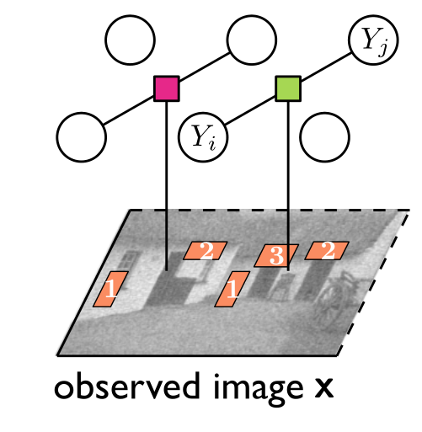
Regression tree field
Combines regression tress (Non-parametric) and Gaussian Random Fields

Slide 85
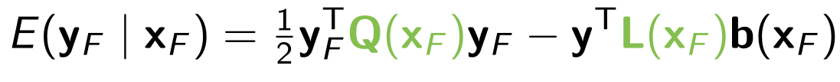
Regression tree field
Combines regression tress (Non-parametric) and Gaussian Random Fields
Energy defined for each factor:
Measure of the goodness of particular labelling given inputs, and parameters of the factor

Slide 86
Regression tree field
Combines regression tress (Non-parametric) and Gaussian Random Fields
Energy defined for each factor:
Measure of the goodness of particular labelling given inputs, and parameters of the factor
Coefficients of are determined by the regression tree, or each leave stores set of parameters.

Slide 87
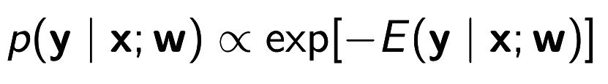

Regression tree field
Combines regression tress (Non-parametric) and Gaussian Random Fields
Energy defined for each factor:
Measure of the goodness of particular labelling given inputs, and parameters of the factor
Coefficients of are determined by the regression tree, or each leave stores set of parameters.
Inference:

Slide 88
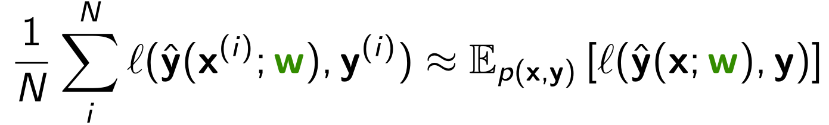
Regression tree field
Combines regression tress (Non-parametric) and Gaussian Random Fields
Energy defined for each factor:
Measure of the goodness of particular labelling given inputs, and parameters of the factor
Coefficients of are determined by the regression tree, or each leave stores set of parameters.
Inference:
Training: Jointly choosing the structure of the tree, and parameters of at leaves such that minimizes the empirical risk, in greedy way:

Slide 89
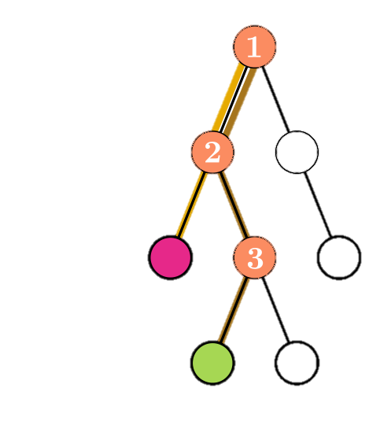
Regression tree fields, for demosaicing
[1] RFS filters: http://www.robots.ox.ac.uk/~vgg/research/texclass/filters.html

Slide 90
Regression tree fields, for demosaicing
Tree Feature checks,
A preliminary bilinear interpolation
[1] RFS filters: http://www.robots.ox.ac.uk/~vgg/research/texclass/filters.html

Slide 91
Regression tree fields, for demosaicing
Tree Feature checks,
A preliminary bilinear interpolation
RFS filters [1] which act like derivatives in different directions, with various scales
[1] RFS filters: http://www.robots.ox.ac.uk/~vgg/research/texclass/filters.html

Slide 92
Regression tree fields, for demosaicing
Tree Feature checks,
A preliminary bilinear interpolation
RFS filters [1] which act like derivatives in different directions, with various scales
Quadratic energy basis vectors,
Set of neightbouring pixels,
[1] RFS filters: http://www.robots.ox.ac.uk/~vgg/research/texclass/filters.html

Slide 93
Regression tree fields, for demosaicing
Tree Feature checks,
A preliminary bilinear interpolation
RFS filters [1] which act like derivatives in different directions, with various scales
Quadratic energy basis vectors,
Set of neightbouring pixels,
RFS filter responses
[1] RFS filters: http://www.robots.ox.ac.uk/~vgg/research/texclass/filters.html

Slide 94
Regression tree fields, for demosaicing
Raw Spcae
Mosaiced Linear Space
Demosaiced Linear Space
sRGB Space
[1] RFS filters: http://www.robots.ox.ac.uk/~vgg/research/texclass/filters.html

Slide 95
Raw Spcae
Regression tree fields, for demosaicing
The generalized loss function,
Mosaiced Linear Space
Demosaiced Linear Space
sRGB Space
[1] RFS filters: http://www.robots.ox.ac.uk/~vgg/research/texclass/filters.html

Slide 96
Raw Spcae
Regression tree fields, for demosaicing
The generalized loss function,
An approximate camera pipeline, from linear-space, to sRGB space, which is differentiable
An analytic approximation for gamma transform
Mosaiced Linear Space
Demosaiced Linear Space
sRGB Space
[1] RFS filters: http://www.robots.ox.ac.uk/~vgg/research/texclass/filters.html

Slide 97
Raw Spcae
Regression tree fields, for demosaicing
The generalized loss function,
An approximate camera pipeline, from linear-space, to sRGB space, which is differentiable
An analytic approximation for gamma transform
An approximate 3x3 color transform,
Mosaiced Linear Space
Demosaiced Linear Space
sRGB Space
[1] RFS filters: http://www.robots.ox.ac.uk/~vgg/research/texclass/filters.html

Slide 98
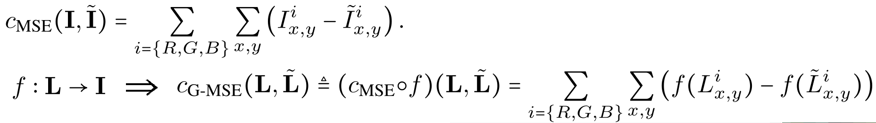
Raw Spcae
Regression tree fields, for demosaicing
The generalized loss function,
An approximate camera pipeline, from linear-space, to sRGB space, which is differentiable
An analytic approximation for gamma transform
An approximate 3x3 color transform,
Mosaiced Linear Space
2
Demosaiced Linear Space
sRGB Space
[1] RFS filters: http://www.robots.ox.ac.uk/~vgg/research/texclass/filters.html

Slide 99
Raw Spcae
Regression tree fields, for demosaicing
The generalized loss function,
An approximate camera pipeline, from linear-space, to sRGB space, which is differentiable
An analytic approximation for gamma transform
An approximate 3x3 color transform,
Mosaiced Linear Space
2
2
Demosaiced Linear Space
sRGB Space
[1] RFS filters: http://www.robots.ox.ac.uk/~vgg/research/texclass/filters.html

Slide 100
Raw Spcae
Regression tree fields, for demosaicing
The generalized loss function,
An approximate camera pipeline, from linear-space, to sRGB space, which is differentiable
An analytic approximation for gamma transform
An approximate 3x3 color transform,
Stacking RTFs,
Mosaiced Linear Space
2
2
Demosaiced Linear Space
sRGB Space
Mosaiced image
RTF1
RTF2
[1] RFS filters: http://www.robots.ox.ac.uk/~vgg/research/texclass/filters.html

Slide 101
Experiments(1)

Slide 102
Experiments(1)
Demosaicing, in linear-space, without noise:

Slide 103
Experiments(2)

Slide 104
Experiments(2)
Demosaicing, in linear-space, without noise:

Slide 105
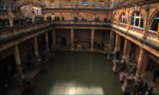
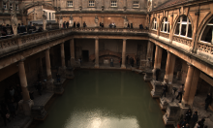
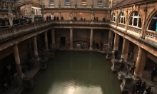

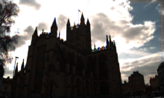
Some samples
NAT: Non-Local Adaptive Thresholding:
NLM: Non-Local Means

Slide 106
Some samples
Ground truth Bilinear CS RTF
NAT: Non-Local Adaptive Thresholding:
NLM: Non-Local Means

Slide 107
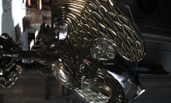
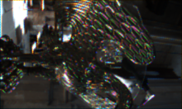
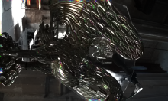
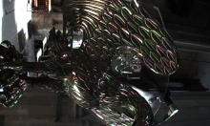
Some samples
NAT: Non-Local Adaptive Thresholding:
NLM: Non-Local Means

Slide 108
Some samples
NAT: Non-Local Adaptive Thresholding:
NLM: Non-Local Means

Slide 109
Some samples
Ground truth Bilinear CS RTF
NAT: Non-Local Adaptive Thresholding:
NLM: Non-Local Means

Slide 110


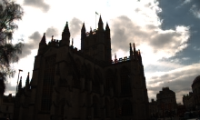
Image Margins
NAT: Non-Local Adaptive Thresholding:
NLM: Non-Local Means

Slide 111
Image Margins
Not a considerable margin in RTF outputs
NAT: Non-Local Adaptive Thresholding:
NLM: Non-Local Means

Slide 112
Image Margins
Not a considerable margin in RTF outputs
NAT NLM OneStepAP RTF
NAT: Non-Local Adaptive Thresholding:
NLM: Non-Local Means

Slide 113
And more to go ….

Slide 114
And more to go ….
RTF with the generalized loss function

Slide 115
And more to go ….
RTF with the generalized loss function
Full denoising-demosiacing experiments

Slide 116
And more to go ….
RTF with the generalized loss function
Full denoising-demosiacing experiments
Other CFA patterns: Fuji-Xtrans pattern

Slide 117
And more to go ….
RTF with the generalized loss function
Full denoising-demosiacing experiments
Other CFA patterns: Fuji-Xtrans pattern
Further work?!

